Slide 1


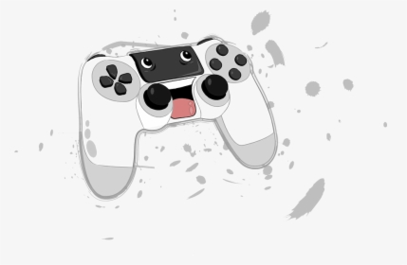


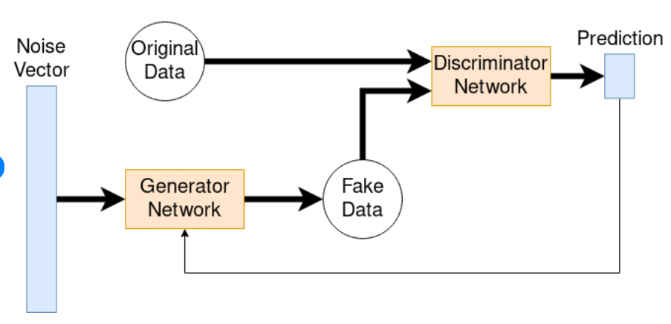

Machine Learning & Video Games
Machine learning has transformed the gaming industry by enhancing gameplay experiences and improving game by Graphics, Realism, Smarter NPC’s, In-game Communication, Fraud and Churn Detection.
For 3D rendering and graphics, recently researchers used a sort of unsupervised deep learning method known as Generative Adversarial Networks (GANs)
Researchgate.net

Slide 2



Software Companies
Organization which developed quality smarter video games :
EA(Testing), Ubisoft(NPC), NVIDIA(Tracing, Graphics), EPIC(AI behavior, content generation) .
Game balancing
Q – Learning Technique
144p
In video games we mostly use Q-Learning technique which is reinforcement learning to create intelligent and adaptive game characters, optimize game strategies. It's a popular method for solving problems where an agent interacts with an environment, takes actions, and receives feedback in the form of rewards or penalties.
Q new(s, a) = Q(s, a) + α * [R + γ * max(Q(s', a')) ]
720p

Slide 3
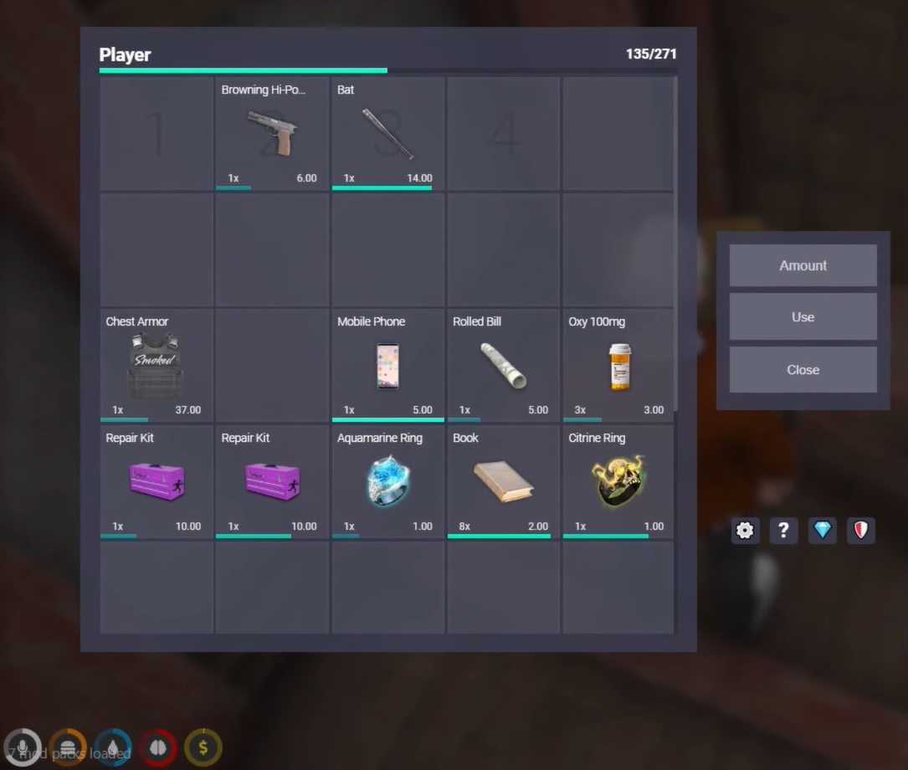

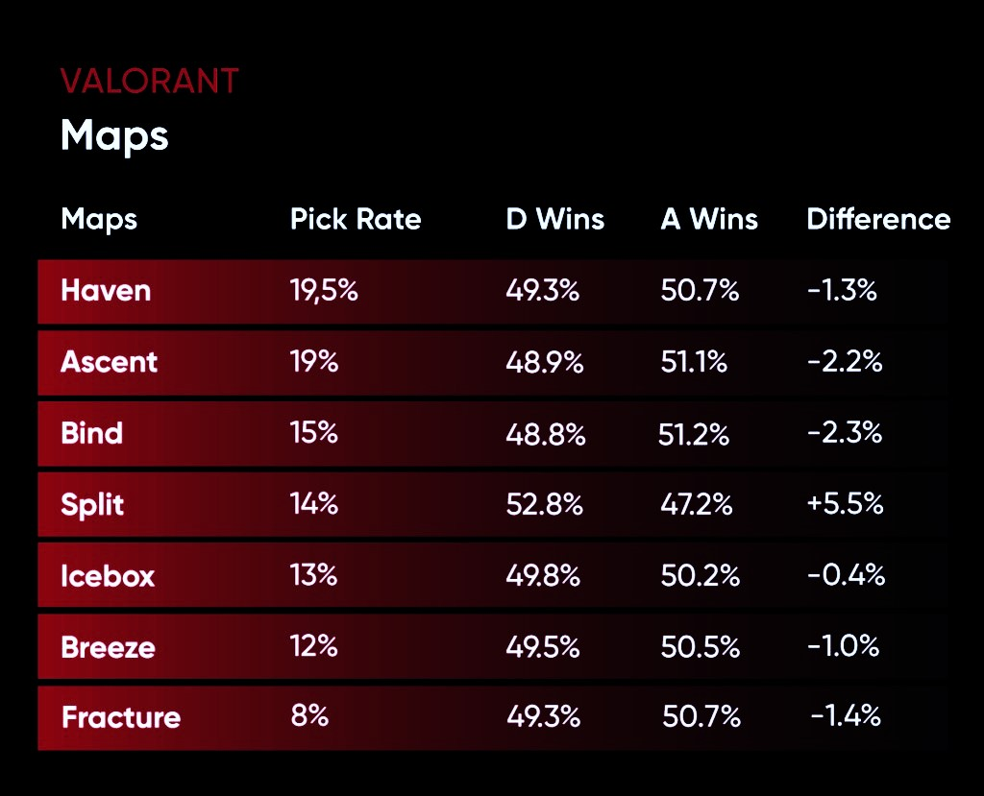
Uses Of Linear And Logistic Regression
Linear regression helps in Understanding :
Players Progression Analysis, Performance Optimization (CPU,RAM) and Economic analysis.
Polynomial regression is a variation of linear regression in which it maintains and stores:
Player Level Progression, In- Game Currency, Weapon or Item Strength.
Logistic regression is statistical model technique which is used to analyze :
Player Churn Prediction, Fraud Detection, Sentiment Analysis and Skill Level Estimation.
Reference Source –
REFERENCE RAKAZONE
Internet , Wikipedia , Researchgate.net

